Slide 1
COT5615: Math for Intelligent Systems I
Anand Rangarajan
Lecture 31

Slide 2
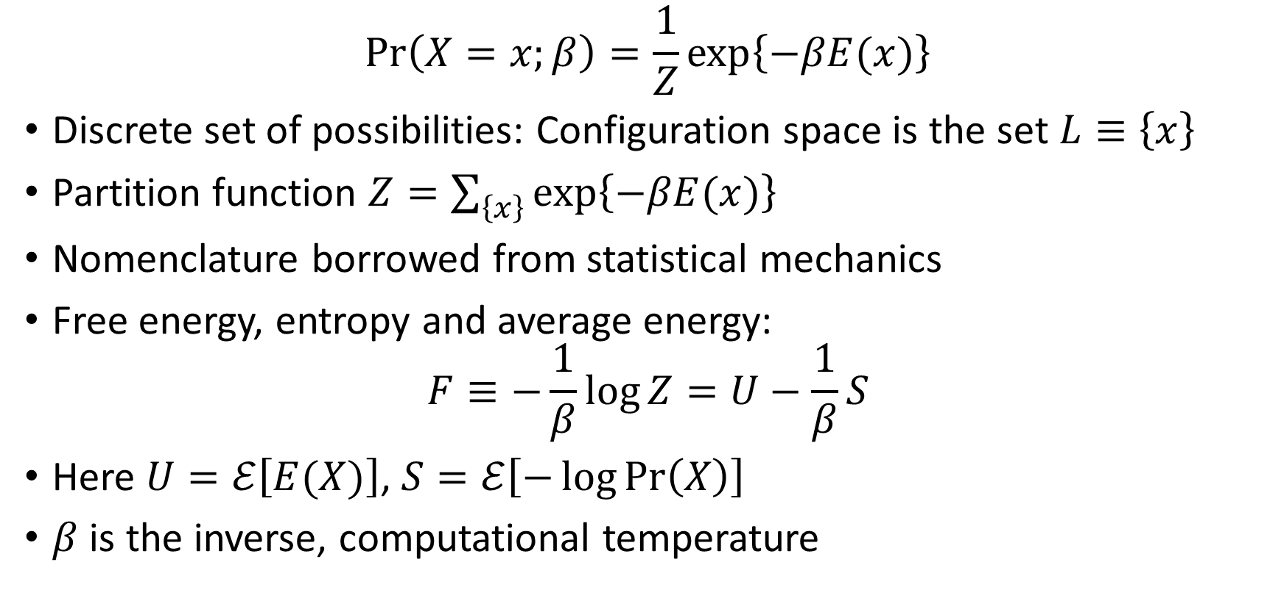
The Gibbs Distribution
$$\operatorname{Pr}\left(X=x;β\right)=\frac{1}{Z}\exp\left\{−βE(x)\right\}$$
Discrete set of possibilities: Configuration space is the set $L≡\left\{x\right\}$
Partition function $Z=\sum_{\left\{x\right\}}{\exp\left\{−βE(x)\right\}}$
Nomenclature borrowed from statistical mechanics
Free energy, entropy and average energy:
$$F≡−\frac{1}{β}\log{Z}=U−\frac{1}{β}S$$
Here $U=ℰ\left[E(X)\right]$, $S=ℰ\left[−\log{\operatorname{Pr}\left(X\right)}\right]$
$β$ is the inverse, computational temperature
Notes:
Pr gives the probability of the system X being in state x (equivalently, of the random variable X having value x)
E(x) is interpreted as the energy of the configuration x

Slide 3
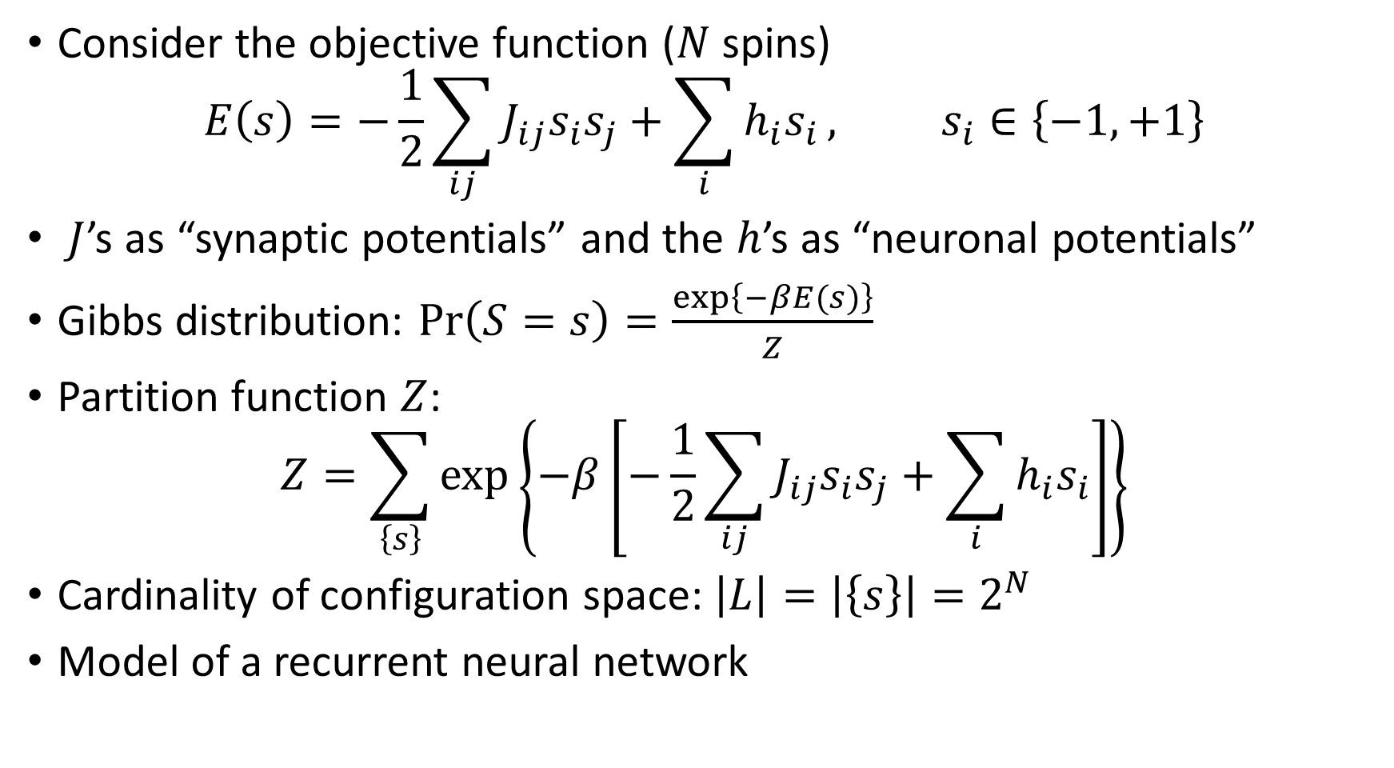
Spin Systems: A More Complex Example
Consider the objective function ($N$ spins)
$$E\left(s\right)=−\frac{1}{2}\sum_{ij}{J_{ij}s_{i}s_{j}}+\sum_{i}{h_{i}s_{i}}, s_{i}∈\left\{−1,+1\right\}$$
$J$’s as “synaptic potentials” and the $h$’s as “neuronal potentials”
Gibbs distribution: $\operatorname{Pr}\left(S=s\right)=\frac{\exp\left\{−βE(s)\right\}}{Z}$
Partition function $Z$:
$$Z=\sum_{\left\{s\right\}}{\exp\left\{−β\left[−\frac{1}{2}\sum_{ij}{J_{ij}s_{i}s_{j}}+\sum_{i}{h_{i}s_{i}}\right]\right\}}$$
Cardinality of configuration space: $\left|L\right|=\left|\left\{s\right\}\right|=2^{N}$
Model of a recurrent neural network

Slide 4
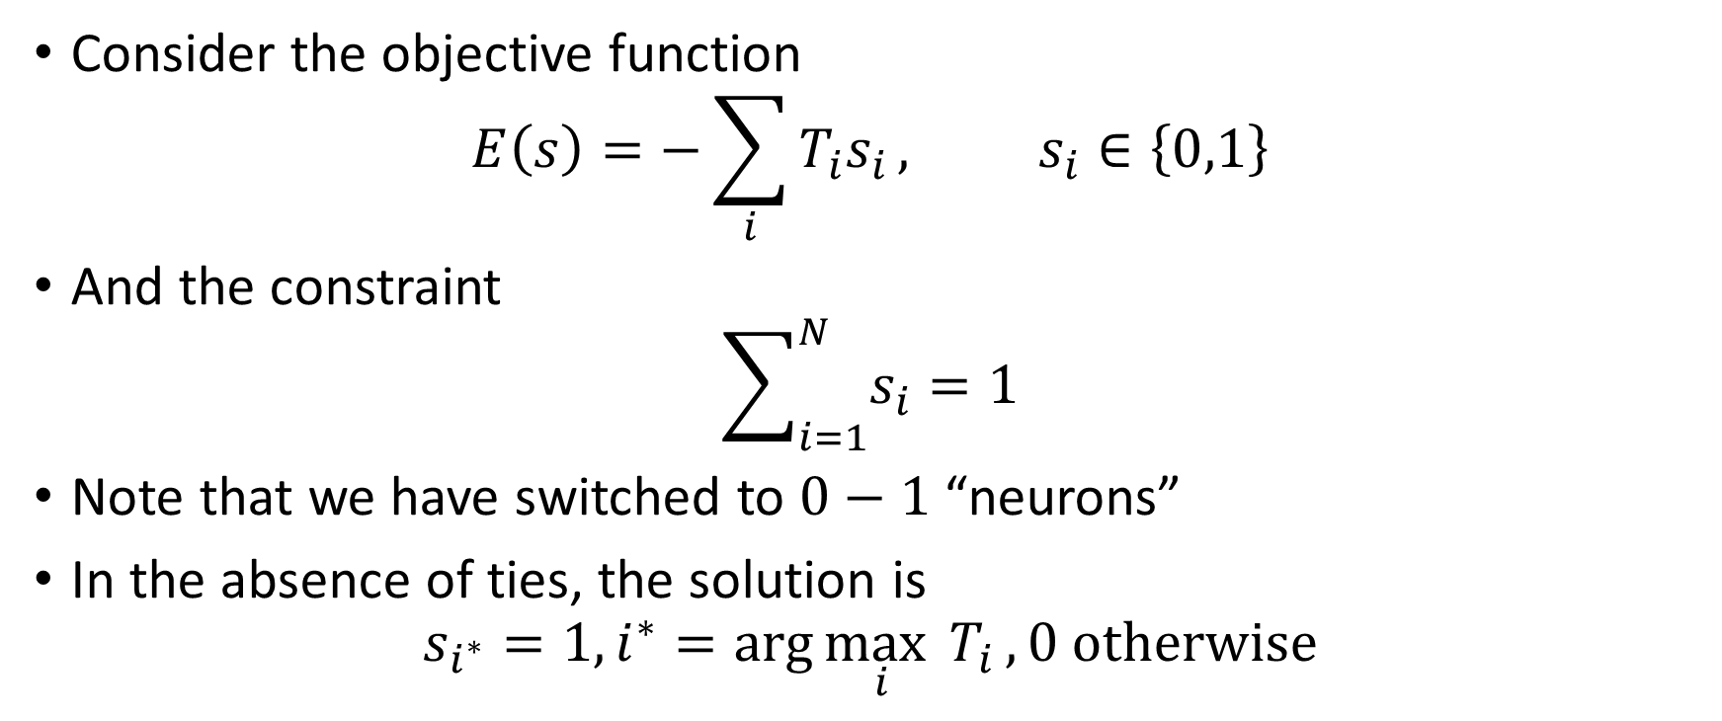
The Winner-Take-All
Consider the objective function
$$E\left(s\right)=−\sum_{i}{T_{i}s_{i}}, s_{i}∈\left\{0,1\right\}$$
And the constraint
$$\sum_{i=1}^{N}{s_{i}}=1$$
Note that we have switched to $0−1$ “neurons”
In the absence of ties, the solution is
$$s_{i^{∗}}=1, i^{∗}=\arg{\max_{i}{T_{i}}}, 0 otherwise$$

Slide 5
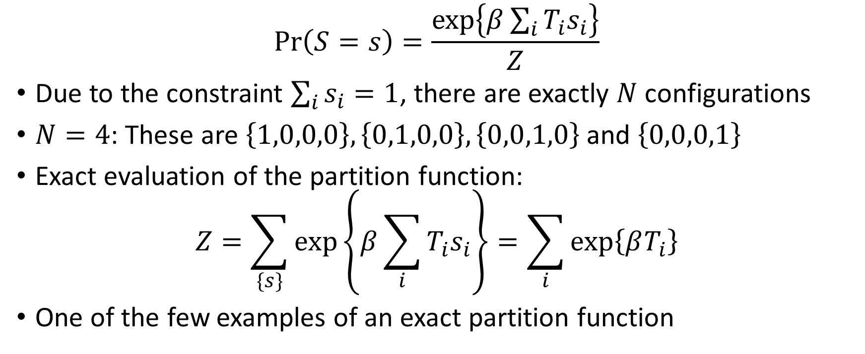
Winner-Take-All (WTA): Gibbs Distribution
$$\operatorname{Pr}\left(S=s\right)=\frac{\exp\left\{β\sum_{i}{T_{i}s_{i}}\right\}}{Z}$$
Due to the constraint $\sum_{i}{s_{i}}=1$, there are exactly $N$ configurations
$N=4$: These are $\left\{1,0,0,0\right\}, \left\{0,1,0,0\right\}, \left\{0,0,1,0\right\}$ and $\left\{0,0,0,1\right\}$
Exact evaluation of the partition function:
$$Z=\sum_{\{s\}}{\exp\left\{β\sum_{i}{T_{i}s_{i}}\right\}}=\sum_{i}{\exp\left\{βT_{i}\right\}}$$
One of the few examples of an exact partition function
Notes:
Since there are 2^n configuratins we are not calculate the exact value of this partition function. So we had to use some approximate value.

Slide 6
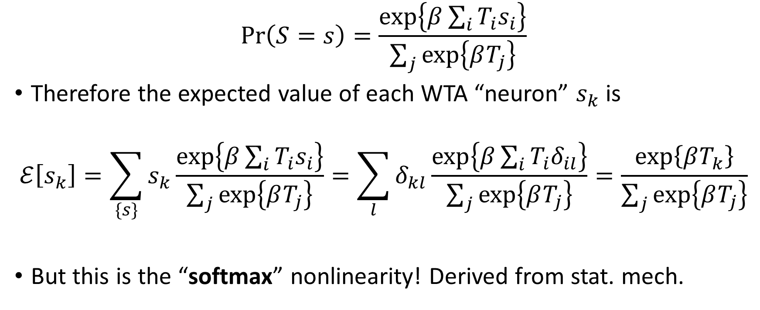
WTA: Analysis
$$\operatorname{Pr}\left(S=s\right)=\frac{\exp\left\{β\sum_{i}{T_{i}s_{i}}\right\}}{\sum_{j}{\exp\left\{βT_{j}\right\}}}$$
Therefore the expected value of each WTA “neuron” $s_{k}$ is
$$ℰ\left[s_{k}\right]=\sum_{\{s\}}{s_{k}}\frac{\exp\left\{β\sum_{i}{T_{i}s_{i}}\right\}}{\sum_{j}{\exp\left\{βT_{j}\right\}}}=\sum_{l}{δ_{kl}\frac{\exp\left\{β\sum_{i}{T_{i}δ_{il}}\right\}}{\sum_{j}{\exp\left\{βT_{j}\right\}}}}=\frac{\exp\left\{βT_{k}\right\}}{\sum_{j}{\exp\left\{βT_{j}\right\}}}$$
But this is the “softmax” nonlinearity! Derived from stat. mech.
Notes:
Sometimes to identilfy an outlier we have one more configuration of all 0's. So, here when suppose an image comes along which does not belong to any of the trained classes, then this could be used to identify it as an outlier.
Instead of winner take all, if we can have 2 winners. Then in the configurations we can have 1 ones and 2 ones. For example, 01000, 01100. Total number of configurations : NC1 + NC2

Slide 7
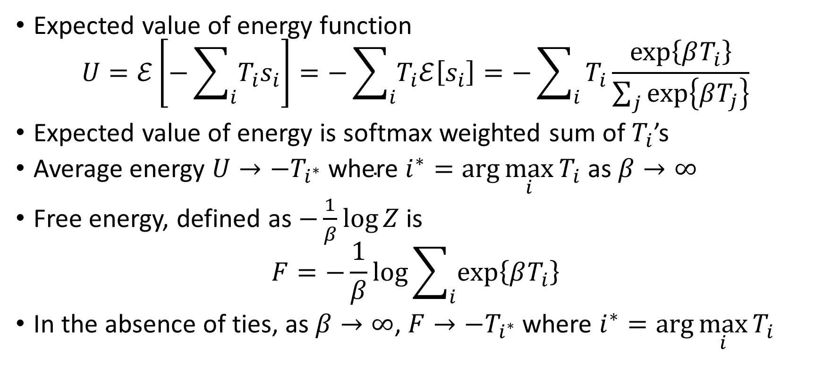
WTA Analysis (contd.)
Expected value of energy function
$$U=ℰ\left[−\sum_{i}{T_{i}s_{i}}\right]=−\sum_{i}{T_{i}ℰ\left[s_{i}\right]}=−\sum_{i}{T_{i}\frac{\exp\left\{βT_{i}\right\}}{\sum_{j}{\exp\left\{βT_{j}\right\}}}}$$
Expected value of energy is softmax weighted sum of $T_{i}$’s
Average energy $U→{−T}_{i^{∗}} \text{where} i^{∗}=\arg{\max_{i}{T_{i}}}$ as $β→∞$
Free energy, defined as $−\frac{1}{β}\log{Z}$ is
$$F=−\frac{1}{β}\log{\sum_{i}{\exp\left\{βT_{i}\right\}}}$$
In the absence of ties, as $β→∞$, $F→−T_{i^{∗}}$ where $i^{∗}=\arg{\max_{i}{T_{i}}}$

Slide 8
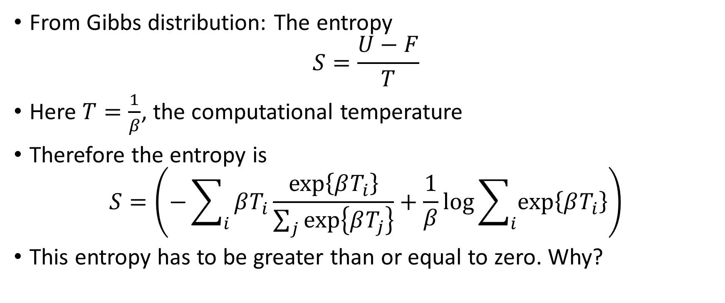
WTA Analysis (fini)
From Gibbs distribution: The entropy
$$S=\frac{U−F}{T}$$
Here $T=\frac{1}{β}$, the computational temperature
Therefore the entropy is
$$S=\left(−\sum_{i}{βT_{i}\frac{\exp\left\{βT_{i}\right\}}{\sum_{j}{\exp\left\{βT_{j}\right\}}}}+\frac{1}{β}\log{\sum_{i}{\exp\left\{βT_{i}\right\}}}\right)$$
This entropy has to be greater than or equal to zero. Why?

Slide 9
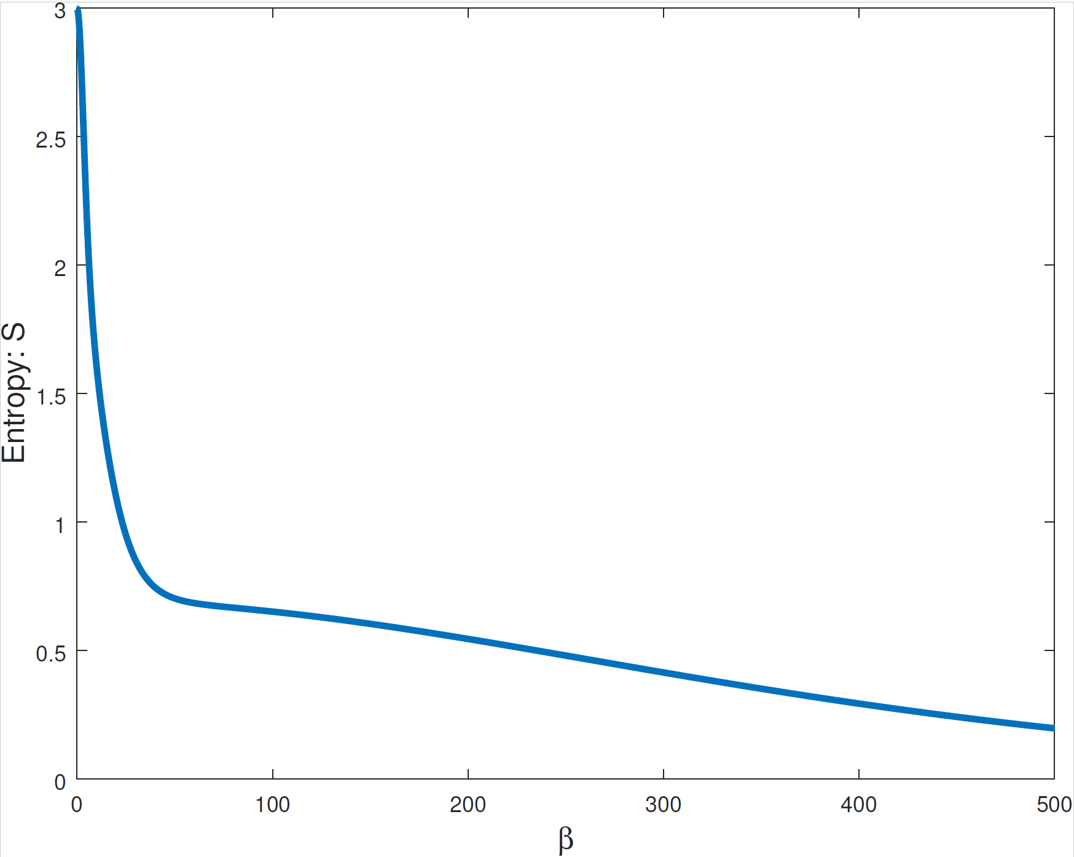
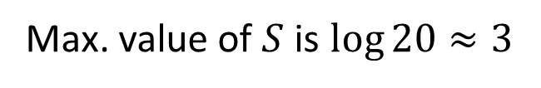
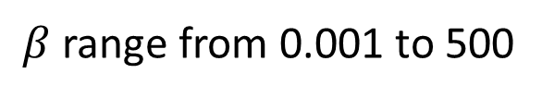

WTA Plots: Entropy
$$N=20, T values in \left[0,1\right]$$
$β$ range from 0.001 to 500
Max. value of $S$ is $\log{20}≈3$

Slide 10
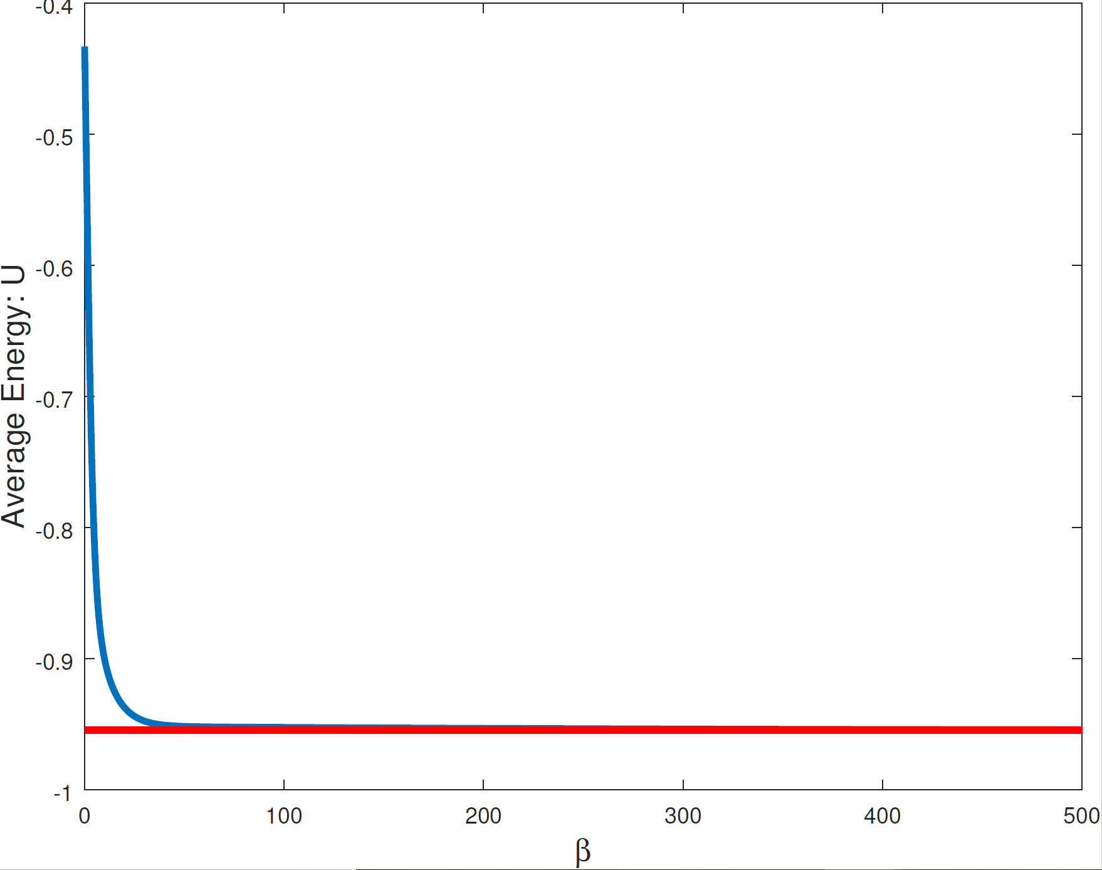
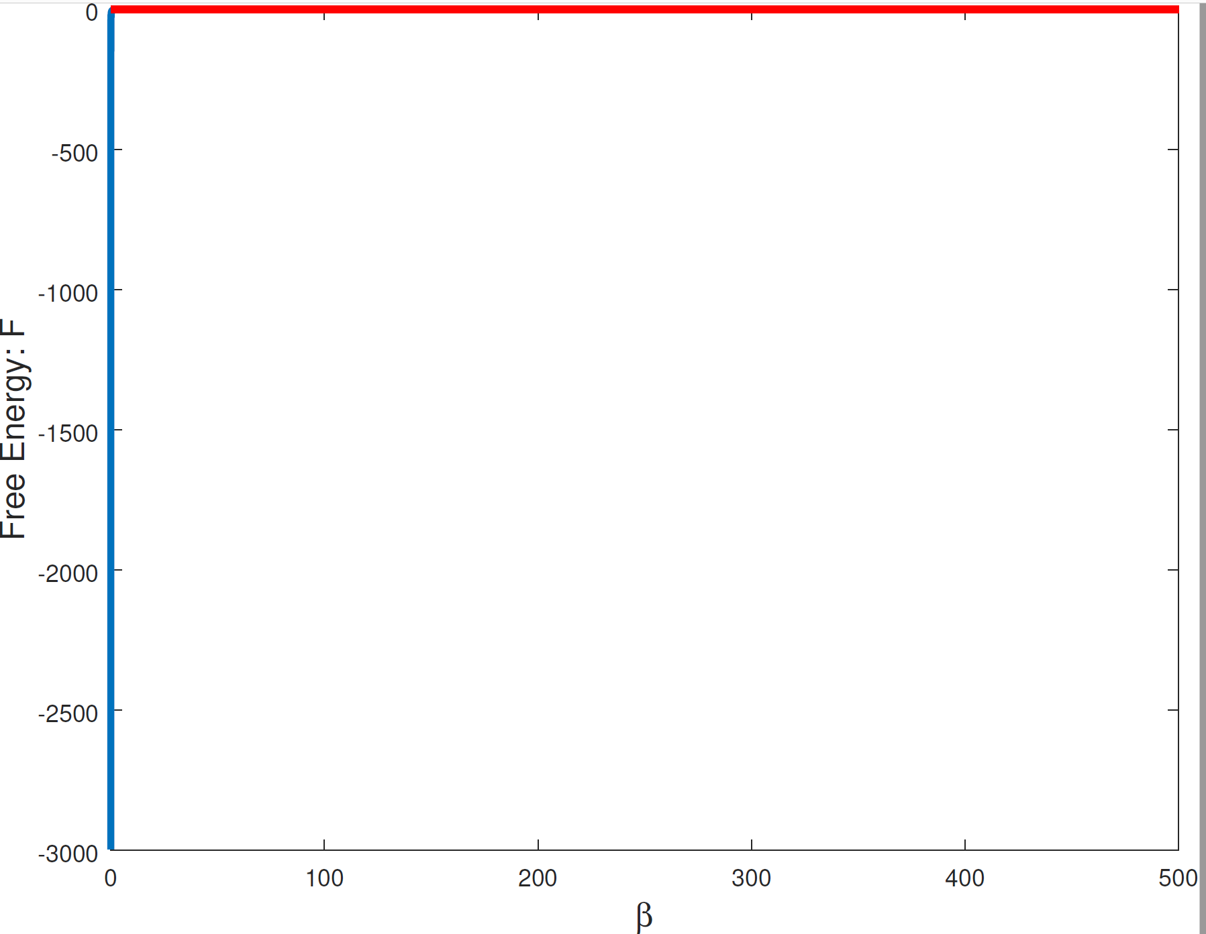
WTA Plots: Average Energy and Free Energy

Slide 11
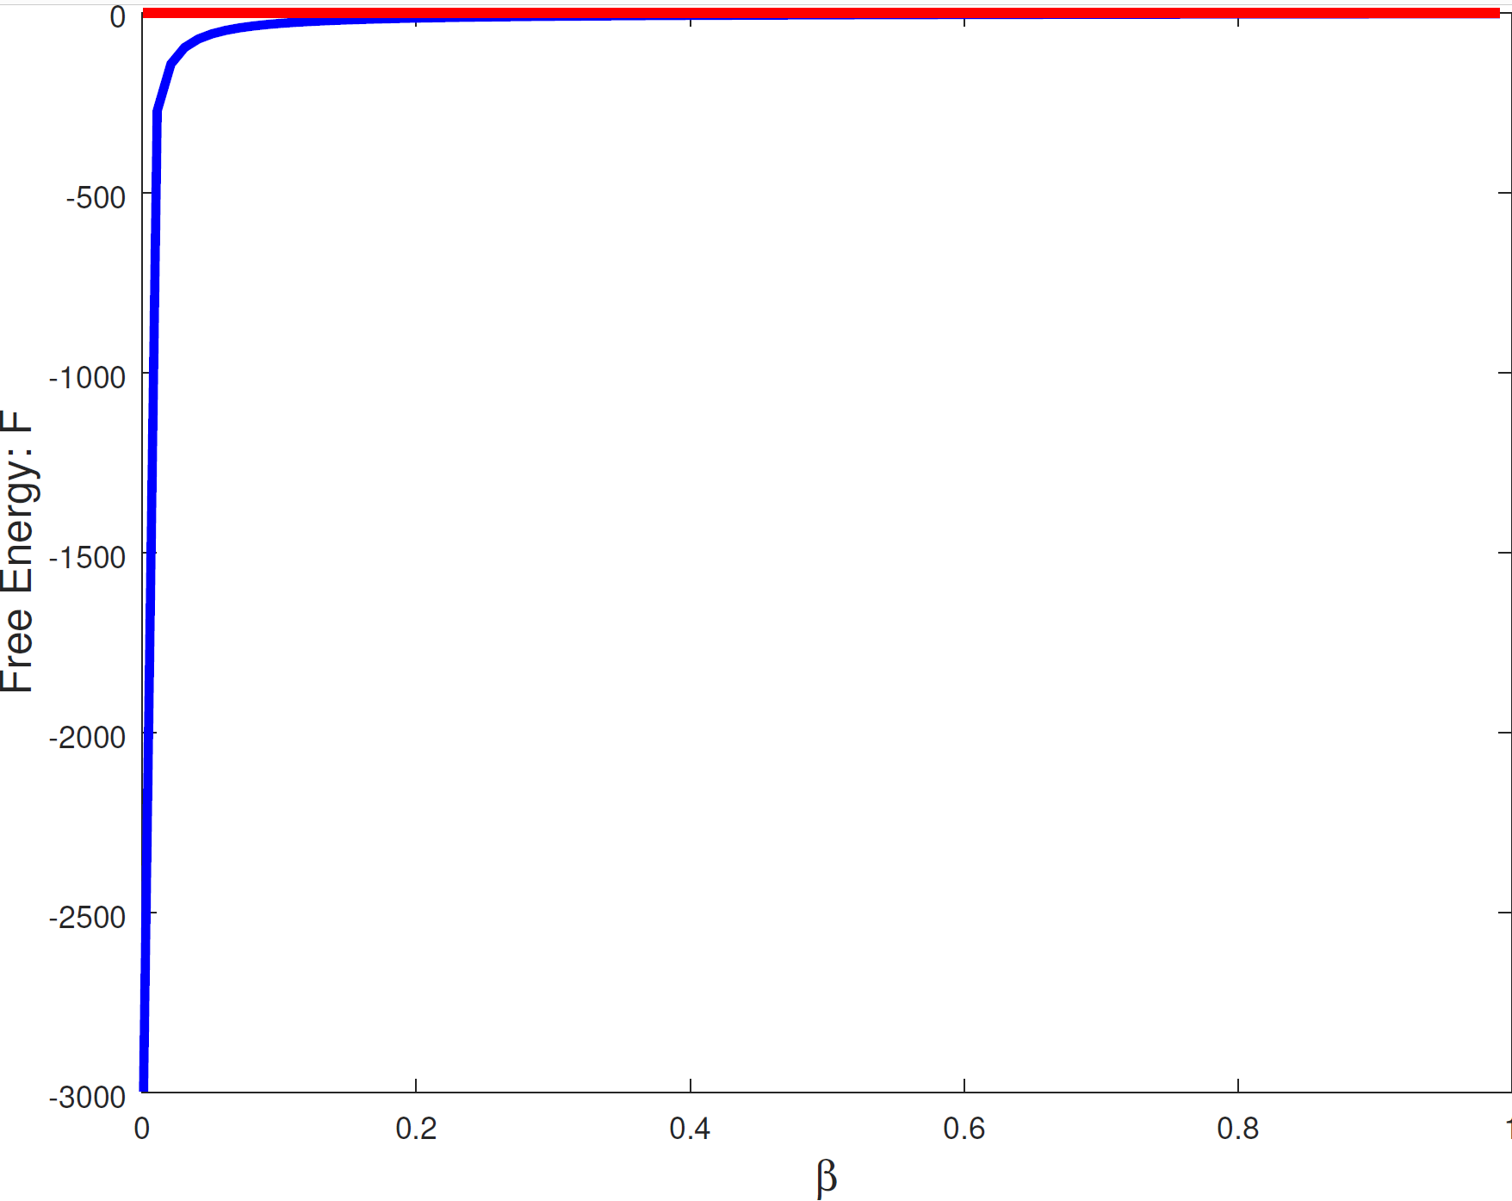
WTA Plots: Free Energy

